Slide 1
Engineering Mechanics
By
Dr. Pradipta Basu Mandal
Dept. of Mechanical Engineering
Techno India University

Slide 2
Distributed Forces

Slide 3
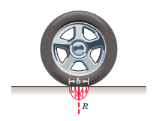
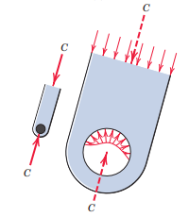
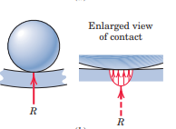
Concentrated and Distributed Forces

Slide 4
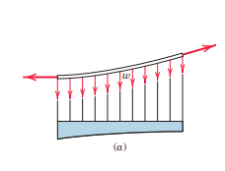
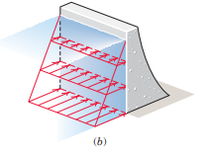

[ w ] = N/m, kN/m, kgf/m, N/mm
Distributed Force has units of Pressure
[P] = Pa, kPa, MPa, bar
[b] = N/m^3, N/mm^3

Slide 5
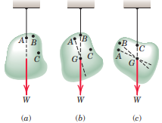
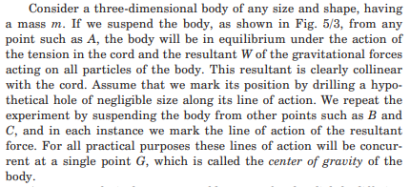

Slide 6
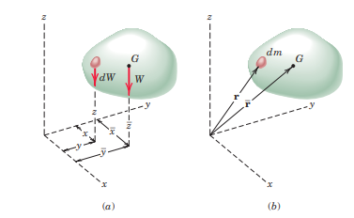


Slide 7

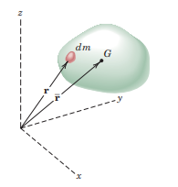






Slide 8


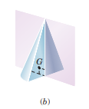
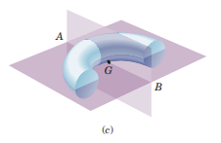
We can take advantage of the geometrical symmetry is it exists.

Slide 9
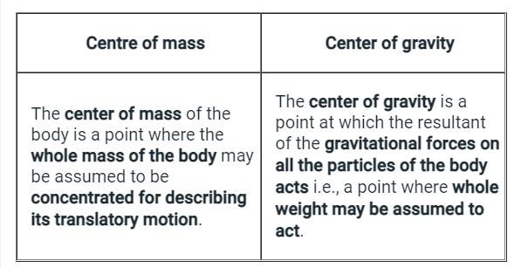

Slide 10

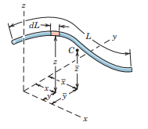



Slide 11
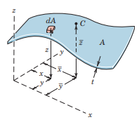



Slide 12
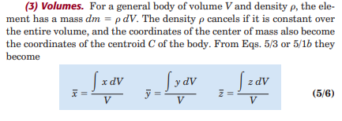

Slide 13
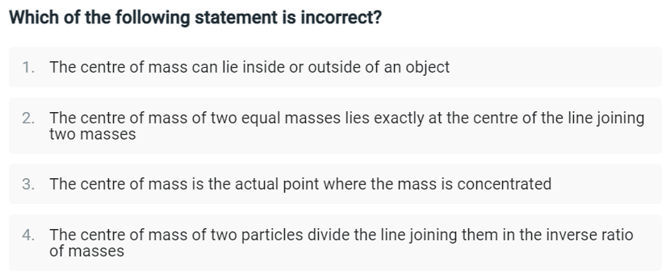
Example

Slide 14
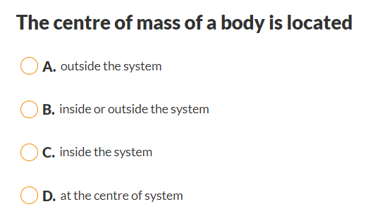
Example

Slide 15
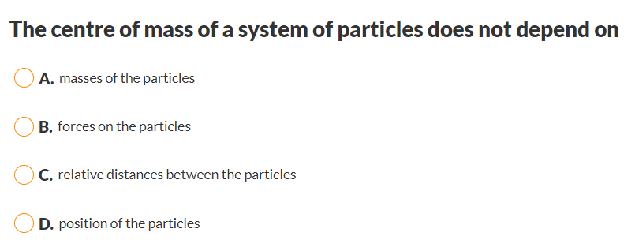
Example

Slide 16

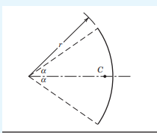

Slide 17
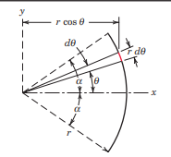
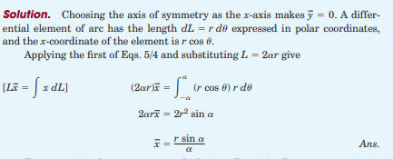


Slide 18
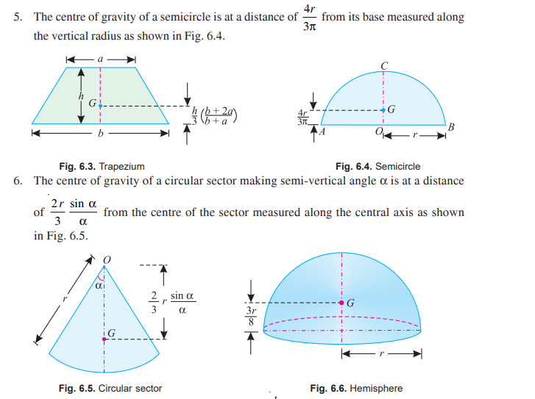

Slide 19
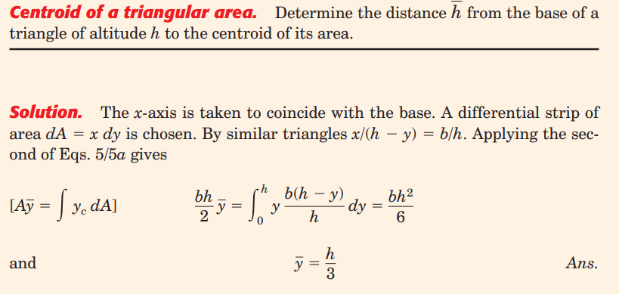
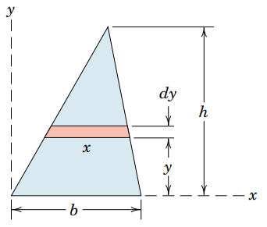

Slide 20

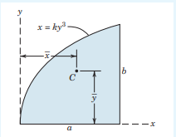
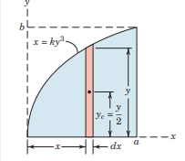






Slide 21

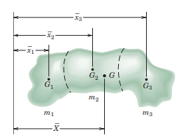


Slide 22
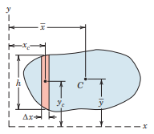

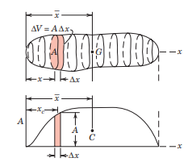



Slide 23
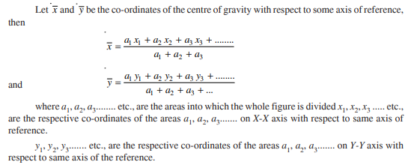

Slide 24
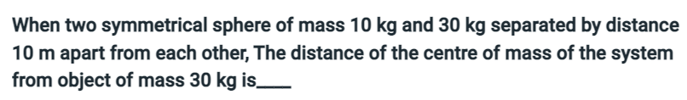
Example
Ans :
Example

Slide 25
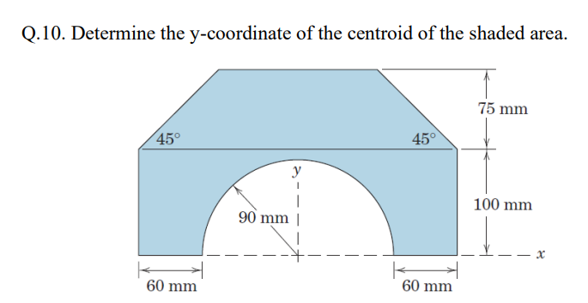

Slide 26
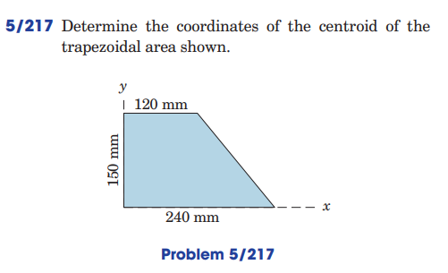

Slide 27
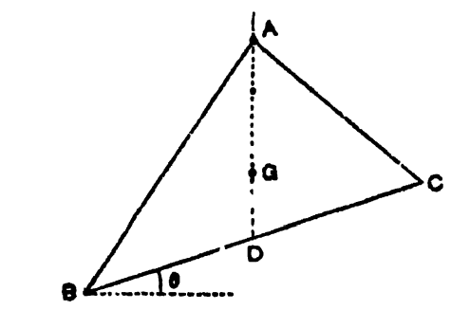
Example
A triangular lamina ABC hangs at rest, with one of the angles A being supported at a fixed point. Find the angle which the lower side makes with the horizon.

Slide 28

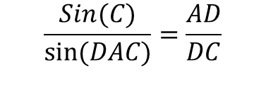
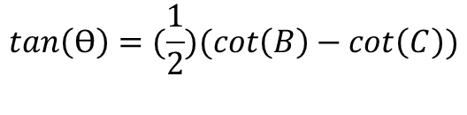


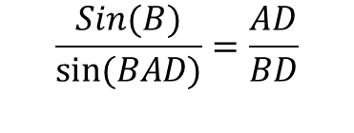


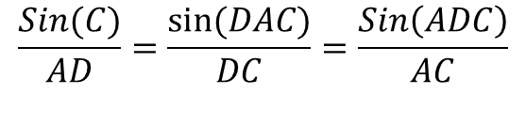


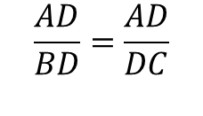

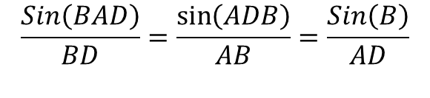
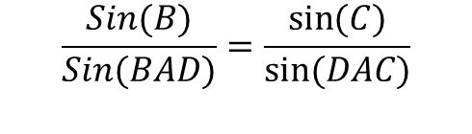
Solution
$$BD=DC Angle ADC=90 − ϴ$$
$$Angle ADB=90+ ϴ$$
$$Angle BAD=ADC−B$$
$$=90−ϴ−B$$
$$Angle DAC=ADB−C$$
$$=90+ ϴ−C$$
$$\frac{AD}{BD}=\frac{AD}{DC}$$
$$\frac{Sin\left(BAD\right)}{BD}=\frac{\sin\left(ADB\right)}{AB}=\frac{Sin\left(B\right)}{AD}$$
$$\frac{Sin(B)}{sin⁡(BAD)}=\frac{AD}{BD}$$
$$\frac{Sin(C)}{AD}=\frac{\sin{(DAC)}}{DC}=\frac{Sin\left(ADC\right)}{AC}$$
$$\frac{Sin(C)}{sin⁡(DAC)}=\frac{AD}{DC}$$
$$\frac{Sin(B)}{Sin(BAD)}=\frac{\sin{(C)}}{sin⁡(DAC)}$$
$$Sin\left(B\right)∗Sin\left(90+Ɵ−C\right)=Sin\left(C\right)∗Sin(90−Ɵ−B)$$
$$Sin\left(B\right)∗cos\left(Ɵ−C\right)=Sin\left(C\right)∗cos(Ɵ+B)$$
$$sin\left(B\right)(cos\left(Ɵ)cos\left(C\right)+sin\left(Ɵ\right)sin(C)\right)=sin\left(C\right)(cos\left(Ɵ\right)cos\left(B\right)−\sin{(Ɵ)}\sin\left(B\right))$$
$$tan\left(Ɵ\right)=(\frac{1}{2})(cot\left(B\right)−\cot\left(C\right))$$

Slide 29

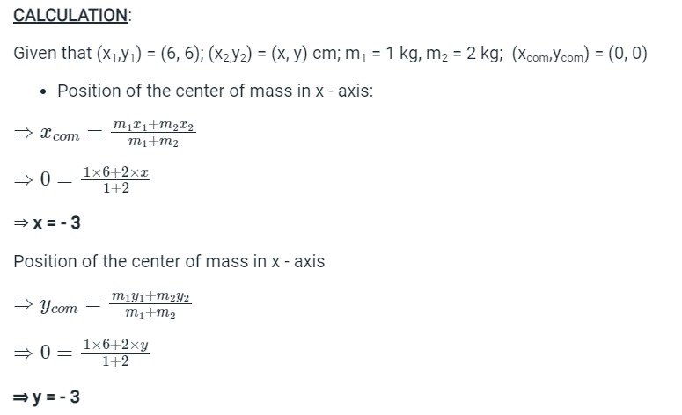
Example

Slide 30
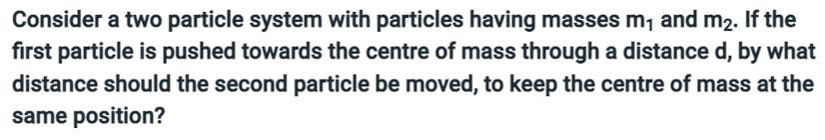
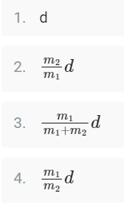
Example

Slide 31
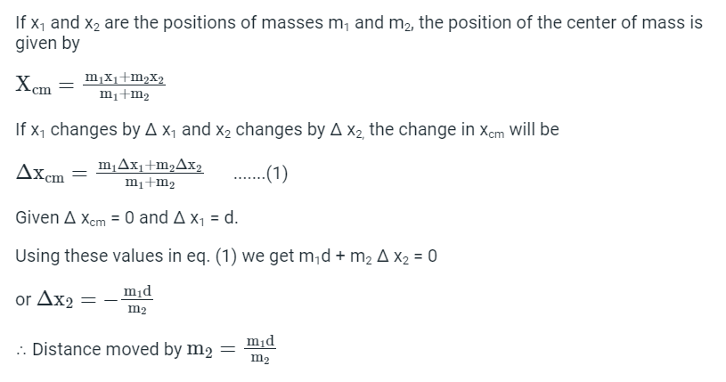
Solution

Slide 32
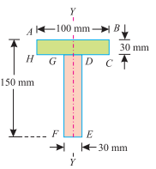
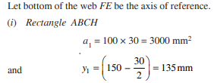




Slide 33
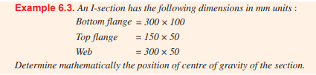
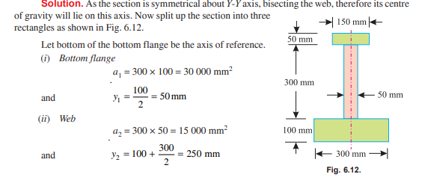






Slide 34
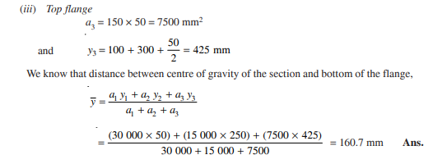


Slide 36




Area Moment of Inertia
(Second Area Moment)
Rectangular Moments of Inertia
Polar Moment of Inertia

Slide 37








Slide 38

Example

Slide 39


Example

Slide 40





Slide 41









C - Centroid
$${\overline{I}}_{x}=\int{y_{0}^{2}}dA$$
$${\overline{I}}_{y}=\int{x_{0}^{2}}dA$$
$$\int{y_{0}}dA=0$$
$$\int{x_{0}}dA=0$$
Moment of Inertia about (x,y)
$$I_{y}= \int{x_{0}^{2}dA+2d_{y}\int{y_{0}}dA+ d_{y}^{2}\int{dA}}$$
(Polar Moment of Inertia)
(Radius of gyration)

Slide 42



Slide 43









Slide 44



Slide 45



Slide 46




Slide 47


Slide 48



Slide 49



Slide 50


Slide 51


Slide 52


Slide 53



Slide 54



Slide 55


Slide 56
Practice Problems

Slide 57

P1

Slide 58


P2
Find the centroids of the following figure.

Slide 59


P3

Slide 60

P4

Slide 61

P4

Slide 62

P6

Slide 63

P7

Slide 64


P8

Slide 65

P9

Slide 66

P10

